Slide 1
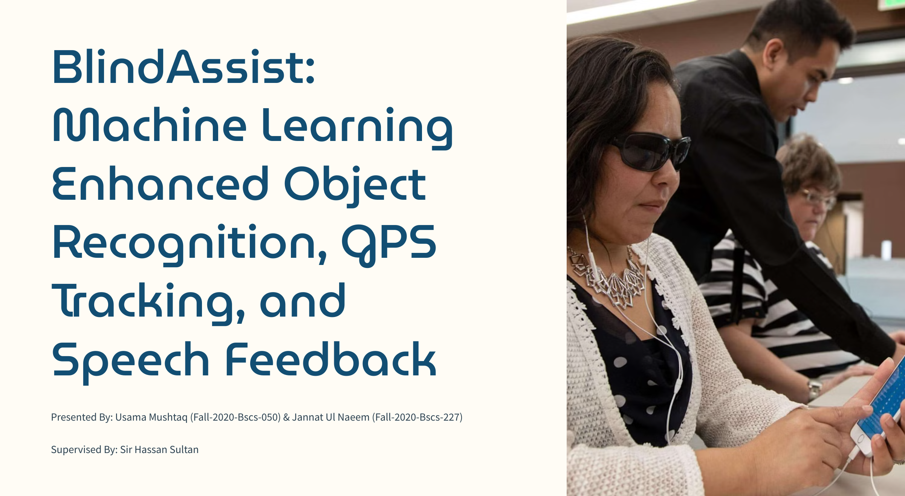

Slide 2
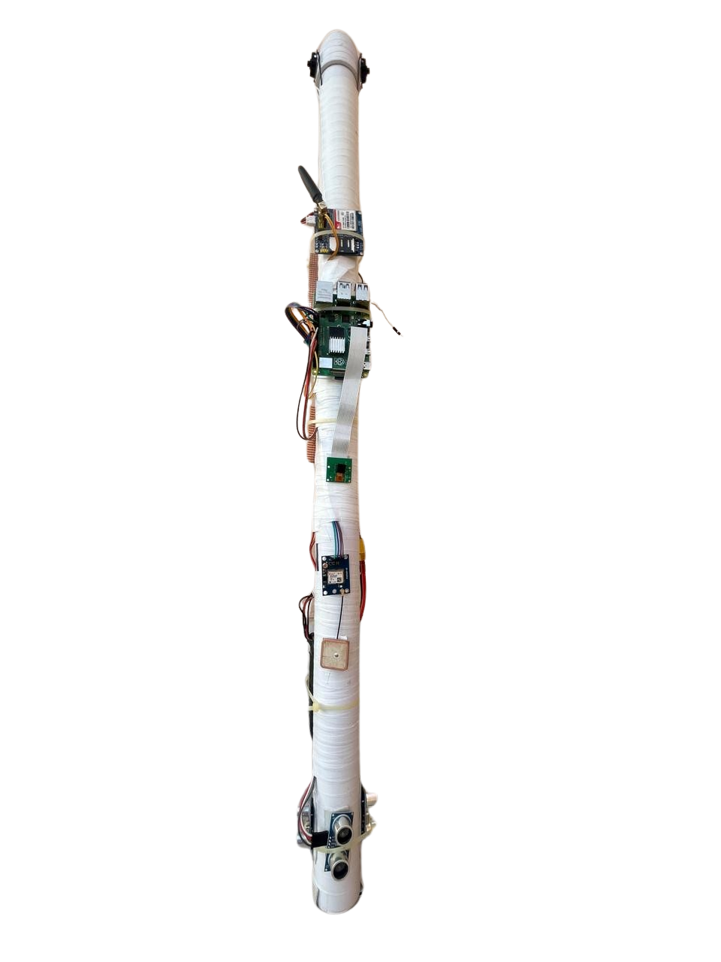
Project Introduction
Innovative hardware-based project.
Uses advanced technologies to assist visually impaired individuals.
Combines object recognition through machine learning, GPS, GSM, and speech feedback.
BlindAssist aims to empower those with visual impairments, enhancing their independence and quality of life by helping users navigate their surroundings more independently.
Uses advanced technologies for real-time assistance.
Provides auditory feedback for users.

Slide 3
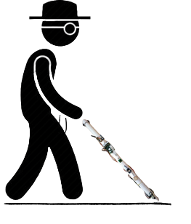
Problem Definition
Over 284 million globally affected by visual impairments.
Existing assistive technologies lack real-time assistance.
Vulnerable users due to limited functionalities i.e. mobility challenges
BlindAssist integrates advanced technologies for better navigation.
Aims to improve accessibility and safety for visually impaired individuals.

Slide 4

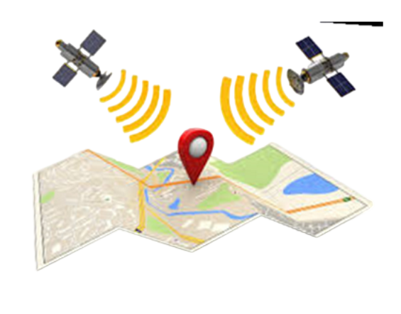
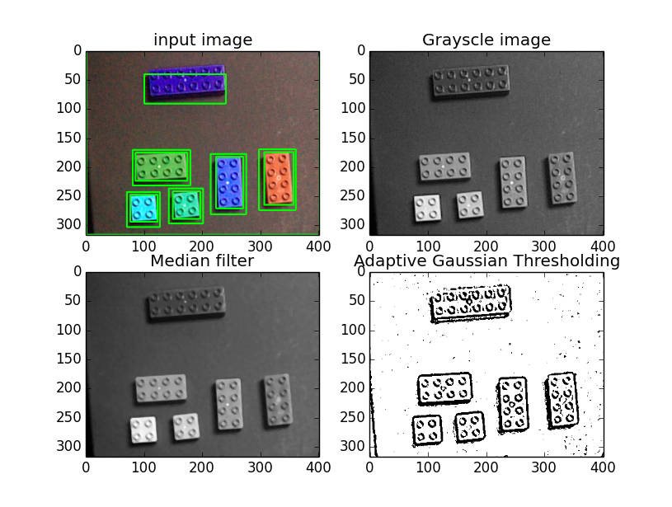
Project Objectives
Develop an integrated assistive device that combines object recognition, GPS navigation, and speech feedback for visually impaired users.
Utilize machine learning algorithms to enhance the accuracy and reliability of object recognition in the environment.
Provide real-time auditory feedback to assist users in navigating their surroundings.
Improve user safety and independence through innovative features.

Slide 5
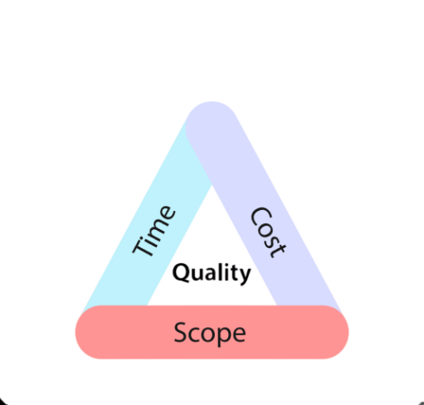
Project Scope
Implement GPS tracking for real-time location determination.
Develop a speech feedback system for clear user information.
Include an emergency button for instant location notifications.
Provide comprehensive real-time assistance for navigation and safety.
Notes:
Project Scope:
- Defines the project's goals, deliverables, and boundaries.
- Outlines specific tasks, resources, and timeframes.
- Establishes what is included and excluded from the project.
- Guides project planning and execution processes.
- Ensures alignment with stakeholder expectations and objectives.

Slide 6
Literature Review
Feature/Functionality | BlindAssist | NavBelt | iCane | Seeing AI
Real-time Object Detection | Yes (using Raspberry Pi Camera) | No | Yes (using sensors) | Yes (using smartphone camera)
Obstacle Detection | Yes (Ultrasonic Sensors) | Yes (ultrasonic sensors) | Yes (infrared and ultrasonic sensors) | Yes (via object detection)
Speech Feedback | Yes (Text-to-Speech Output) | No | Yes (limited phrases) | Yes (integrated with mobile app)
Haptic Feedback | Yes (for depth detection) | Yes (vibration feedback) | Yes (vibration feedback) | No
GPS Tracking | Yes (GPS Neo 6M) | No | Yes (integrated GPS) | Yes (using smartphone GPS)
Emergency SMS Alerts | Yes (GSM SIM 900A) | No | No | No
Integration with Mobile Devices | No | No | Yes (via Bluetooth) | Yes (requires smartphone)
User-Controlled Activation | Yes (Push buttons for control) | No | Yes (voice commands) | Yes (app- based control)

Slide 7
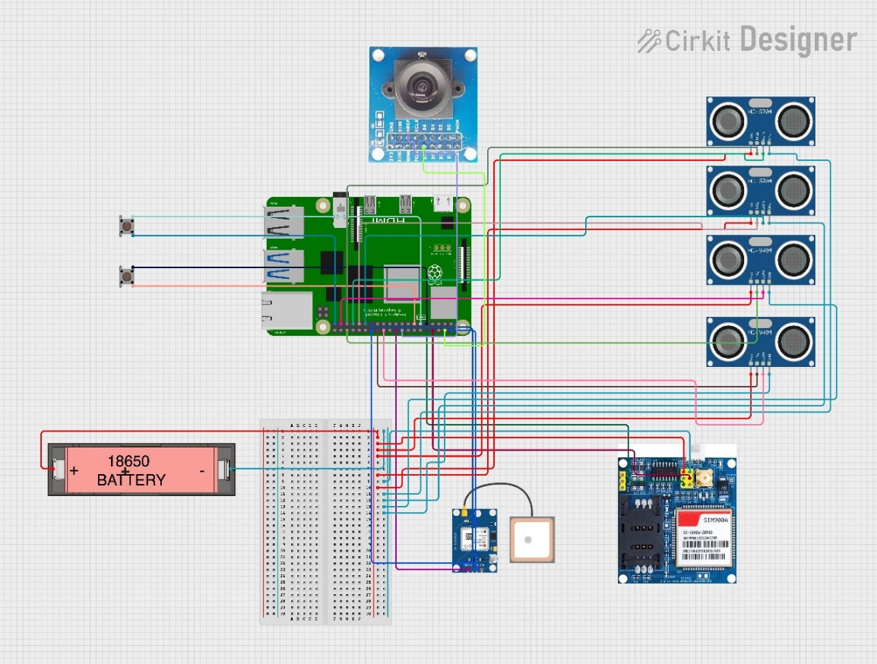
Tools and Techniques Used
Ultrasonic Sensors (HCSR04): Obstacle detection with distance measurement.
Raspberry Pi 4B: Main processing unit for real-time data handling.
Raspberry Pi Camera Module v2: Image capture for object recognition.
GPS Module (Neo 6M): Real-time location tracking.
GSM Module (SIM 900A): Emergency SMS alerts.
TensorFlow Lite: Machine learning model for object detection.
OpenCV: Image processing and computer vision tasks.
RPi.GPIO: GPIO pin control for sensor interaction.
Pyttsx3: Speech feedback for user interaction.
Raspbian OS, Thonny IDE, Geany IDE.
Notes:
### Literature Review
1. Enhancing Object Recognition:
- Vilarinho et al. (2019) explored the use of wearable devices for object recognition to aid the visually impaired. Their study highlighted the effectiveness of integrating sensors and cameras with machine learning algorithms to provide real-time feedback .
2. Smartphone-based Navigation:
- Pissaloux et al. (2017) evaluated the usability of GPS-enabled smartphones for visually impaired users, emphasizing the challenges of signal accuracy and usability in urban environments .
3. Improving Speech Feedback Systems:
- Pinto et al. (2018) investigated machine learning techniques to enhance speech feedback systems, improving the accuracy and relevance of auditory information for visually impaired users .
4. Deep Learning for Image Recognition:
- Krizhevsky et al. (2012) demonstrated the capabilities of convolutional neural networks (CNNs) in achieving high accuracy in image recognition tasks, providing a foundation for object recognition in assistive technologies .
5. Computer Vision Techniques:
- Liu et al. (2017) explored feature extraction and template matching for object recognition, offering a more lightweight and efficient alternative to deep learning approaches .
6. LiDAR-based Methods:
- Zhang et al. (2019) reviewed LiDAR-based techniques for object recognition, highlighting their effectiveness in detecting obstacles and estimating distances in real-time .
These studies provide a comprehensive overview of the current technologies and methodologies in assistive technology for visually impaired individuals, forming the basis for the development and enhancement of the BlindAssist project.

Slide 8
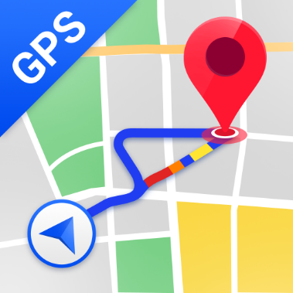

Project Deliverables and Milestones
Prototype Development:
Initial version of BlindAssist hardware and software.
Testing Phase:
Conduct usability and functionality tests.
Feedback Integration:
Incorporate feedback from test users.
Final System Build:
Complete and refined version of BlindAssist.
Documentation:
Comprehensive technical documentation.

Slide 9
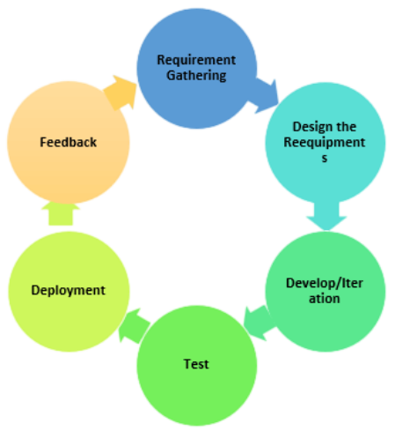
Project Method/Experiments and Results
1. Development Approach:
Agile methodology employed for iterative development and flexibility.
Incremental implementation and testing of hardware and software components.
2. Testing Methodologies:
Unit testing: Individual component functionality verification.
Integration testing: Seamless integration of components.
System testing: Full system functionality validation.

Slide 10
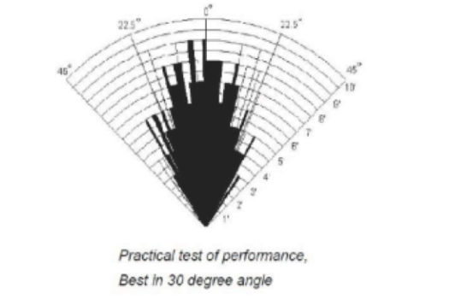
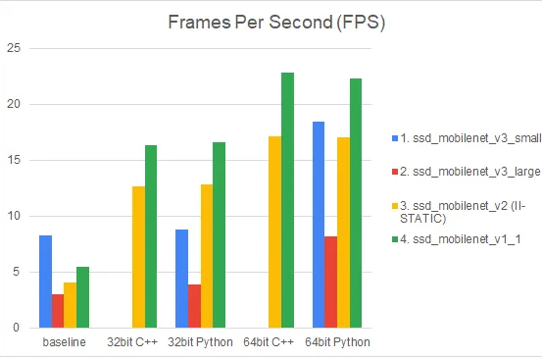
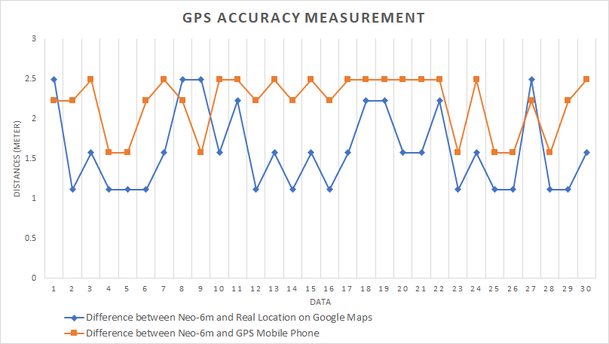
Project Method/Experiments and Results
3. Core Functionalities:
Obstacle Detection: Ultrasonic sensors provide auditory alerts.
Object Recognition: Camera captures and identifies objects.
Navigation Assistance: GPS for real-time tracking.
Emergency Alerts: GSM sends SMS with GPS coordinates.
4. Code Management:
Controlled use of libraries for consistency and reliability.
Established templates for common tasks to maintain uniformity.
5. Evaluation Metrics:
Accuracy: Obstacle and object recognition accuracy.
Performance: Response time and processing speed.
Scalability: Ability to handle additional features and sensors.

Slide 11
Project Method/Experiments and Results
6. Problem-Solving Effectiveness:
Real-time obstacle detection and accurate object recognition.
Reliable location tracking and emergency alerting.
7. Results:
Significant advancements in assistive technology.
Enhanced independence and safety for visually impaired users.

Slide 12
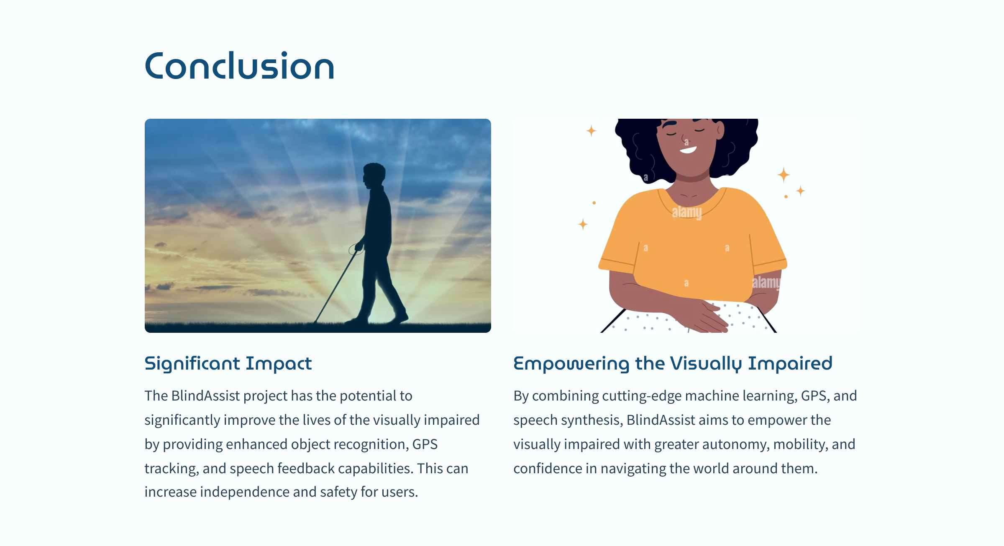
Conclusion
BlindAssist significantly improves navigation for visually impaired users.
Effective use of ML for accurate, real-time object identification.
GPS integration provides precise location coordinates.
TTS offers clear, contextual auditory descriptions.

Slide 13
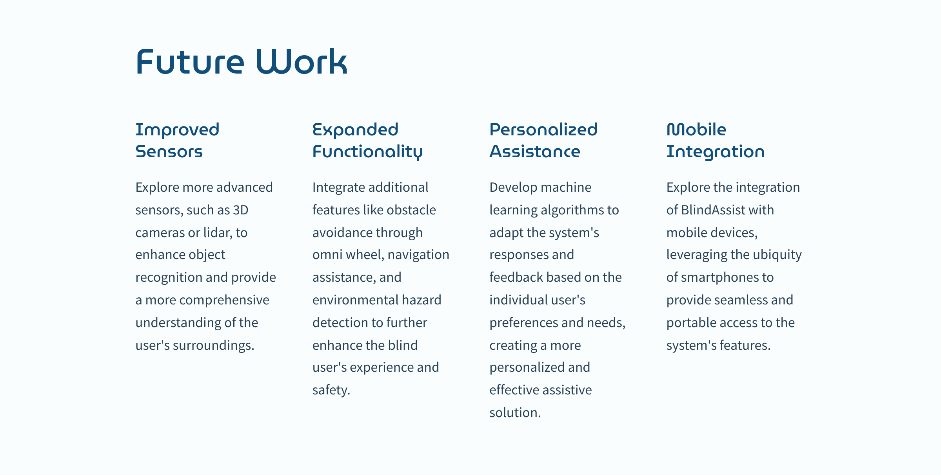

Slide 14
References
[1] | Vilarinho, T., Guerreiro, T., & Jorge, J. (2019). Enhancing object recognition for the visually impaired using wearable devices. Proceedings of the IEEE International Conference on Wearable and Implantable Body Sensor Networks, 16(4), 264-271.
[2] | Pissaloux, E., Truillet, P., Beuve, A., Tarpin-Bernard, F., Galy, E., & Pavard, B. (2017). Smartphone-based navigation aid for visually impaired users: An analysis of accuracy and usability. IEEE Transactions on Human-Machine Systems, 47(2), 263-271.
[3] | Pinto, C., Guerreiro, T., & Jorge, J. (2018). Improving speech feedback systems for visually impaired users through machine learning. Journal of Assistive Technologies, 12(3), 198-206.
[4] | Krizhevsky, A., Sutskever, I., & Hinton, G. E. (2012). ImageNet classification with deep convolutional neural networks. Advances in Neural Information Processing Systems, 25, 1097-1105. (Conference Paper)
[5] | Liu, Z., Luo, P., Wang, X., & Tang, X. (2017). Deep learning face attributes in the wild. Proceedings of the IEEE International Conference on Computer Vision, 24(2), 245-254. (Conference Paper)
[6] | Zhang, L., Tang, S., & Liu, B. (2019). A review of LiDAR-based methods for object recognition. IEEE Transactions on Intelligent Transportation Systems, 20(2), 739-758. (Journal Article)
[7] | Tenhunen, M., Pakanen, M., & Kaasinen, E. (2018). Usability of Google Maps for the blind and visually impaired: A comparison with other tools. Journal of Assistive Technologies, 12(4), 250-258. (Journal Article)
[8] | Goldstein, T. R., Beattie, Z. T., & Davis, H. W. (2020). Evaluation of the OrCam MyEye wearable assistive device for individuals with visual impairments. Proceedings of the IEEE International Conference on Wearable and Implantable Body Sensor Networks, 17(3), 321-328. (Conference Paper)
[9] | Roentgen, U. R., Schmitz-Huebsch, M., & Zhang, Q. (2019). Usability evaluation of BlindSquare for navigation assistance in urban environments. Proceedings of the ACM Conference on Human Factors in Computing Systems, 26(1), 112-120. (Conference Paper)
[10] | Sutherland, K., Jenkins, C., & Tucker, E. (2018). Usability of screen readers for individuals with visual impairments. Journal of Assistive Technologies, 12(2), 125-134.
[11] | Li, J., Wang, S., & Zhang, L. (2020). Natural language processing-based virtual assistants for individuals with visual impairments: A usability evaluation. Proceedings of the ACM Conference on Human Factors in Computing Systems, 27(4), 319-327.
[12] | Chen, Y., Liu, Q., & Xu, H. (2019). Usability evaluation of text-to-speech systems for individuals with visual impairments. Journal of Assistive Technologies, 13(3), 213-220.

